Slide 1
Macro Processor
Design Options
Recursive Macro Expansion
General-Purpose Macro Processors
Macro Processing within Language Translators

Slide 2
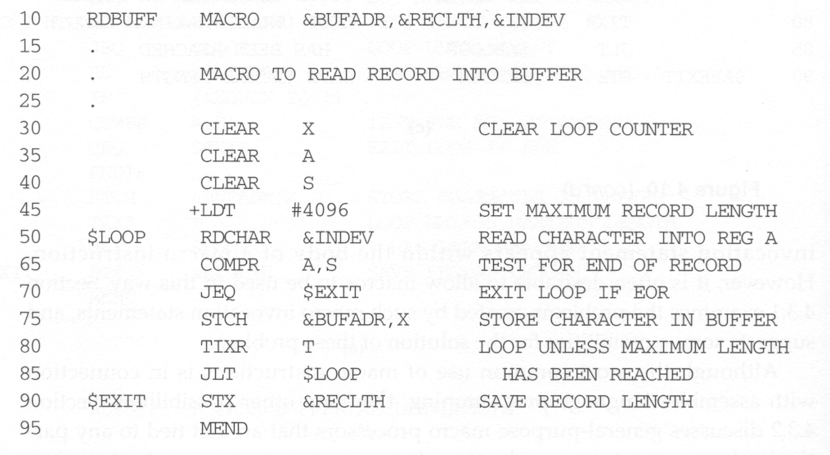
Recursive Macro Expansion

Slide 3
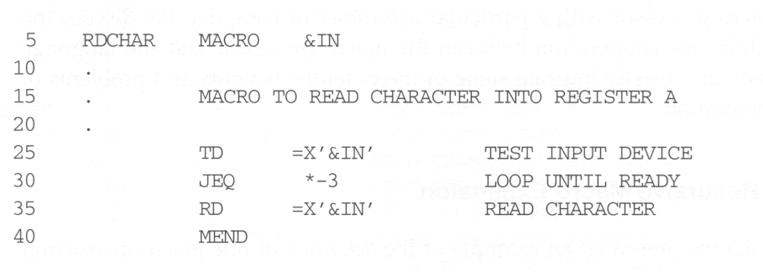
Recursive Macro Expansion
RDCHAR:
  read one character from a specified device into register A
  should be defined beforehand (i.e., before RDBUFF)

Slide 4
Implementation of Recursive Macro Expansion
Previous macro processor design cannot handle such kind of recursive macro invocation and expansion, e.g., RDBUFF BUFFER, LENGTH, F1
  Reasons:
    The procedure EXPAND would be called recursively, thus the invocation arguments in the ARGTAB will be overwritten.
    The Boolean variable EXPANDING would be set to FALSE when the “inner” macro expansion is finished, that is, the macro process would forget that it had been in the middle of expanding an “outer” macro.
    A similar problem would occur with PROCESSLINE since this procedure too would be called recursively.
Solutions:
  Write the macro processor in a programming language that allows recursive calls, thus local variables will be retained.
  Use a stack to take care of pushing and popping local variables and return addresses.
Another problem: can a macro invoke itself recursively?

Slide 5
General-Purpose Macro Processors
Goal:
  macro processors that do not dependent on any particular programming language, but can be used with a variety of different languages
Pros
  Programmers do not need to learn many macro languages.
  Although its development costs are somewhat greater than those for a language-specific macro processor, this expense does not need to be repeated for each language, thus save substantial overall cost.
Cons
  Large number of details must be dealt with in a real programming language
    Situations in which normal macro parameter substitution should not occur, e.g., comments.
    Facilities for grouping together terms, expressions, or statements
    Tokens, e.g., identifiers, constants, operators, keywords
    Syntax

Slide 6
Macro Processing within Language Translators
Macro processors can be
  Preprocessors
    Process macro definitions
    Expand macro invocations
    Produce an expanded version of the source program, which is then used as input to an assembler or compiler
  Line-by-line macro processor
    used as a sort of input routine for the assembler or compiler
      Read source program
      Process macro definitions and expand macro invocations
      Pass output lines to the assembler or compiler
  Integrated macro processor

Slide 7
Line-by-Line Macro Processor
Benefits
  It avoids making an extra pass over the source program.
  Data structures required by the macro processor and the language translator can be combined (e.g., OPTAB and NAMTAB)
  Utility subroutines can be used by both macro processor and the language translator.
    Scanning input lines
    Searching tables
    Data format conversion
  It is easier to give diagnostic messages related to the source statements.

Slide 8
Integrated Macro Processor
An integrated macro processor can potentially make use of any information about the source program that is extracted by the language translator.
As an example in FORTRAN
DO 100 I = 1,20
  a DO statement:
    DO: keyword
    100: statement number
    I: variable name
DO 100 I = 1
  An assignment statement
    DO100I: variable (blanks are not significant in FORTRAN)
An integrated macro processor can support macro instructions that depend upon the context in which they occur.

Slide 9
Drawbacks of Line-by-line or Integrated Macro Processor
They must be specially designed and written to work with a particular implementation of an assembler or compiler.
The costs of macro processor development is added to the costs of the language translator, which results in a more expensive software.
The assembler or compiler will be considerably larger and more complex.

